Slide 1
Task 3 – Dashboard Design
📊 Tool Used: Power BI 📁 Dataset: Superstore Sales Dataset (Kaggle)

Slide 2
KPI SUMMARY Key Performance Indicators
Metric | Value
Total Sales | ₹2.26M
Total Orders | 9800 Orders
Time Period | 2015–201

Slide 3
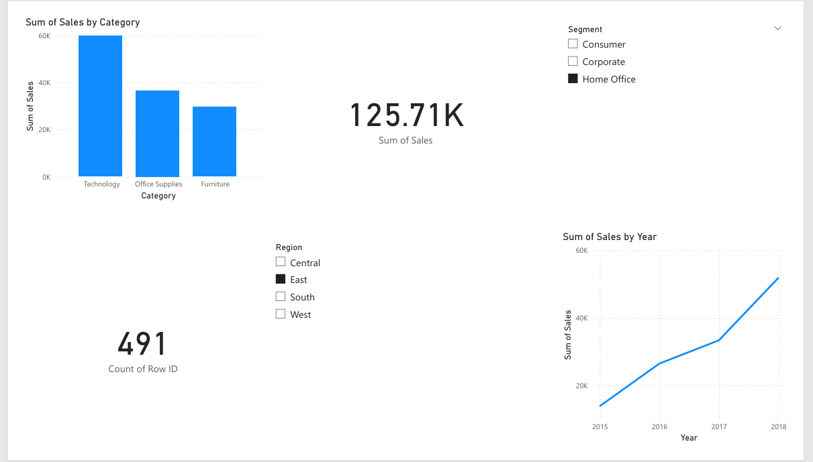
Interactive Sales Dashboard (Power BI)

Slide 4
Insights & Recommendations
Key Business Insights
Technology category leads in total sales.
Steady growth in sales over the years, with a peak in 2018.
Consumer segment contributes the most revenue.
West & Central regions show strong market presence.

